Slide 1
UNIT – I
Hopfield Networks

Slide 2
John J. Hopfield developed a model in the year 1982 conforming to the asynchronous nature of biological neurons. The networks proposed by Hopfield are known as Hopfield networks and it is his work that promoted construction of the first analog VLSI neural chip. This network has found many useful applications in associative memory and various optimization problems. In this section, two types of network are discussed: discrete and continuous Hopfield networks.

Slide 3
Discrete Hopfield Network
The Hopfield network is an autoassociative fully interconnected single-layer feedback network. It is also a symmetrically weighted network. When this is operated in discrete line fashion it is called as discrete Hopfield network and its architecture as a single-layer feedback network can be called as recurrent. The network takes two-valued inputs: binary (0, 1) or bipolar (+1, -1); the use of bipolar inputs makes rhe analysis easier. The network has symmetrical weights with no self-connections, i.e.,
w_{ij} = w_{ji}; w_{ii} = 0

Slide 4
The key points to be noted in Hopfield net are: only one unit updates its activation at a time; also each unit is found to continuously receive an external signal along with the signals it receives from the other units in the net. When a single-layer recurrent network is performing a sequential updating process, an input pattern is first applied to the network and the network's output is found to be initialized accordingly. Afterwards,
the initializing pattern is removed, and the output that is initialized becomes the new updated input through the feedback connections. The first updated input forces the first updated output, which in turn acts as the second updated input through the feedback interconnections and results in second updated output. This transition process continues until no new, updated responses are produced and the network reaches its equilibrium.

Slide 5
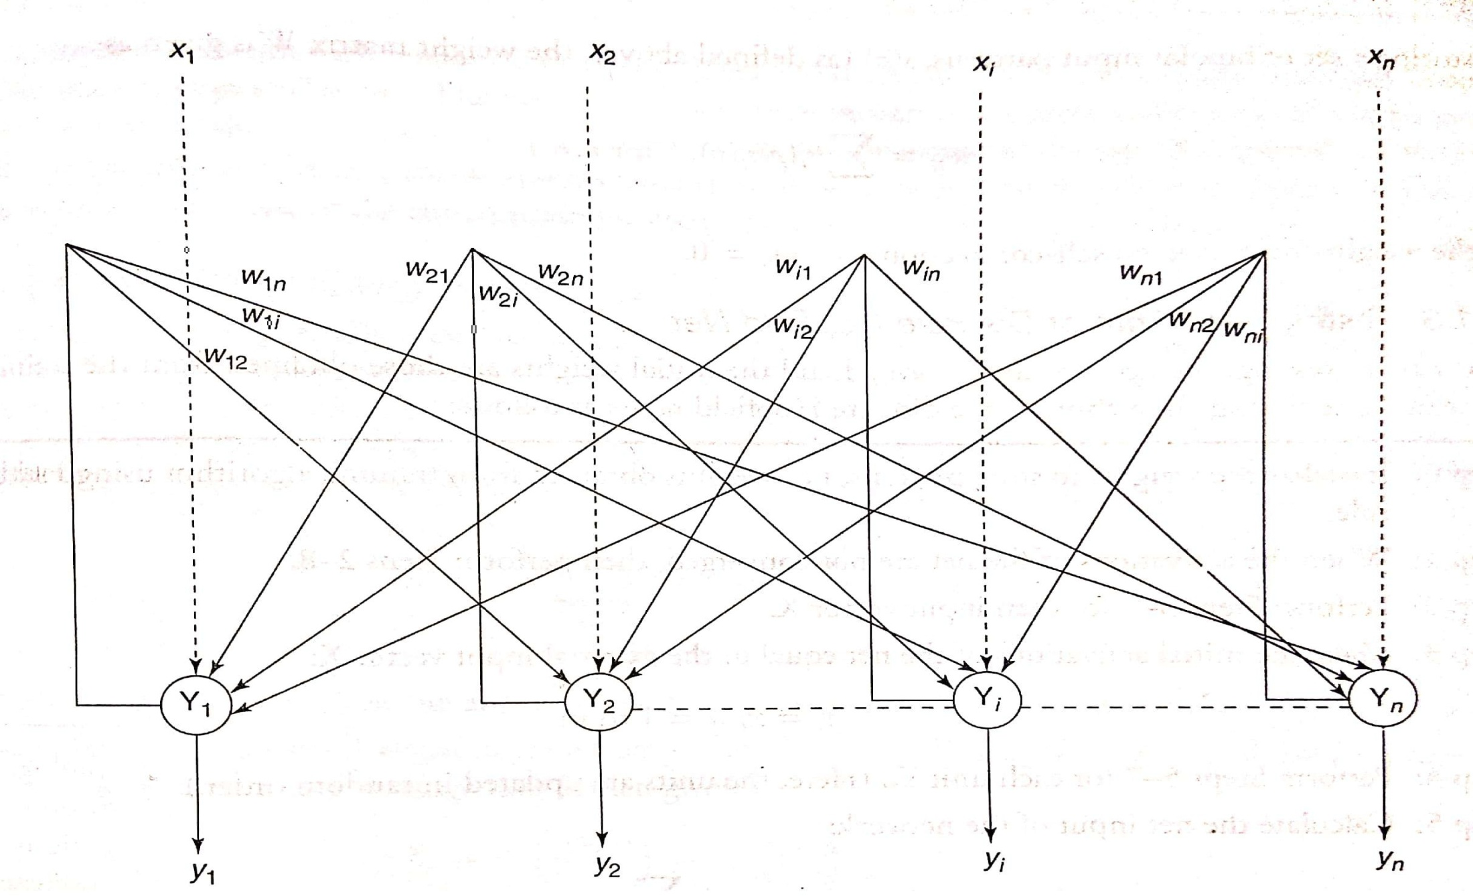
Architecture of Discrete Hopfield Network

Slide 6
The Hopfield's model consists of processing elements with two outputs, one inverting and the other non-inverting. The outputs from each processing element are fed back to the input of other processing elements but not to itself. The connections are found to be resistive and the connection strength over it is represented as w_{ij}. Here, as such there are no negative resistors, hence excitatory connections use positive outputs and inhibitory connections use inverted outputs. Connections are excitatory if the output of a processing element is found to be same as the input, and they are inhibitory if the inputs differ from the output of the processing element. A connection between the processing elements i and j is found to be associated with a connection strength w_{ij} This weight is positive if units i and j are borh on. On the other hand, if the connection strength is negative, it represents the situation of unit i being on and j being off. Also, the weighrs are symmetric, i.e., the weights w_{ij} are same as w_{ji} .

Slide 7
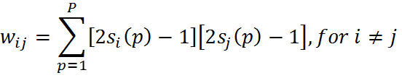
Training Algorithm of Discrete Hopfield Net
There exist several versions of the discrete Hopfield net. It should be noted that Hopfield's first description used binary input vectors and only later on bipolar input vectors used.
For storing a set of binary patterns s(p), p = 1 to P, where s(p) := (s₁(p), ... ,s_{i}(p), ... ,s_{n}(p)), the weight matrix W is given as

Slide 8
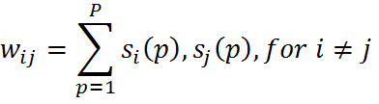
For storing a set of bipolar input patterns, s(p) (as defined above), the weight matrix W is given a
and the weights here have no self-connection, i.e., w_{ij} =0

Slide 9
Testing Algorithm of Discrete Hopfield Net
The testing algorithm for the discrete Hopfield net is as follows:
Step 0: Initialize the weights to store patterns, i.e., weights obtained from training algorithn using Hebb rule.
Step 1: When the activations of the net are not converged, then perform Steps 2-8.
Step 2: Perform Steps 3-7 for each input vector X.
Step 3: Make the inirial activations of the net equal m the external input vector X
y_{i} = x_{i} (i= 1 to n)

Slide 10

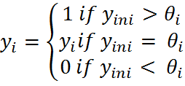
Step 4: Perform Steps 5-7 for each unit Y_{i}. (Here, the units are updated in random order.)
Step 5: Calculate the net input of the network:
Step 6: Apply rhe activations over the net input to calculate the output:
where θ_{i} is the threshold and is normally taken as zero.
Step 7: Now feed back (transmit) the obtained output y_{i} to all other units. Thus, the activation vectors are updated.
Step 8: Finally, test the network for convergence.

